Slide 1
Olist Store Analysis
E-commerce
[Project-P366]
Group 3
Aishwarya Shelar
Prakash Yadav
Jayashree Mendhkar
Swati Bhoomannavar
Shubham Negi
Siddharth Galande

Slide 2
Introduction ( Olist Store )
Olist Store is an E-Commerce platform based in the Brazil that allows small and medium-sized businesses to sell their products online . Olist provides a marketplace where sellers can list their products and reach a larger customer base. As well as tools to help manage their online store, track orders, and handle customer support.
Primary Goal Of Project to :
Identify insights and trends that can help to improve the overall performance Of business.
Identifying top–performing products and categories.
Analysing customer behaviour and preferences.
Analysing sales and revenue trends over time.
Identifying factors that contribute to customer retention
Developing recommendation for targeted marketing Campaigns and promotions.

Slide 3
Data sources
Here is an overview of dataset
Customer_Data – This section includes data related to customers like custId,state,city
Geo_Location_data – Its includes the zipcodes, lantitude & longitude of states and cities
Orders_data – This section includes order related data like ordered,date&time,delivery status
Products data – This category covers information about products related data
Sellers data – This category includers sellers related elements like city state
Review Dataset – This involves customers reviews on orders
Payments dataset – Section Involves payment related methods, payment value Etc
Product category name – includers products name translation in English
Items dataset – this contains Products and items related elements for shipping purpose

Slide 4



Techniques and Tools Used for Implications
Cleaning, remove unavoidable errors, transforming dataset using Ms_Excel.
Replace Missing values and Wrong values with alternative values.
Removed Duplicate values
For Visualization of charts , graphs , tables used Power-BI & Tableau
Perform analyzation using Tableau Dashboards

Slide 5
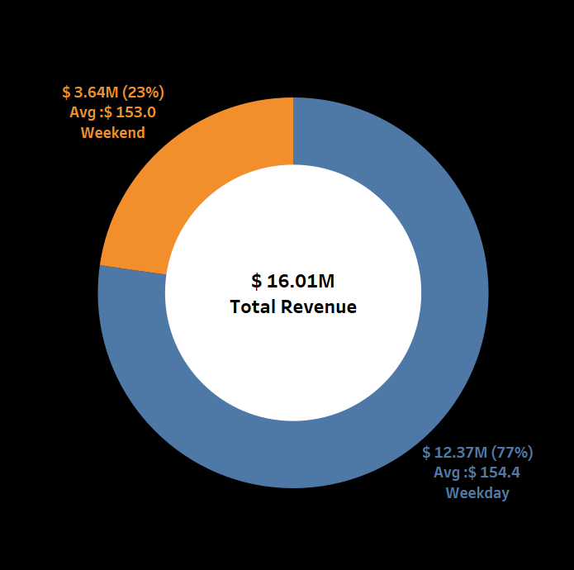
Payment Statistics (Weekend & Weekday)
Total Revenue is $ 16.01 M
Weekday Payments are Approximately $12.37M & Weekend Payments are $ 3.64M
Average Payments on Weekdays ($154.4)and Weekend($153) are nearly similar

Slide 6
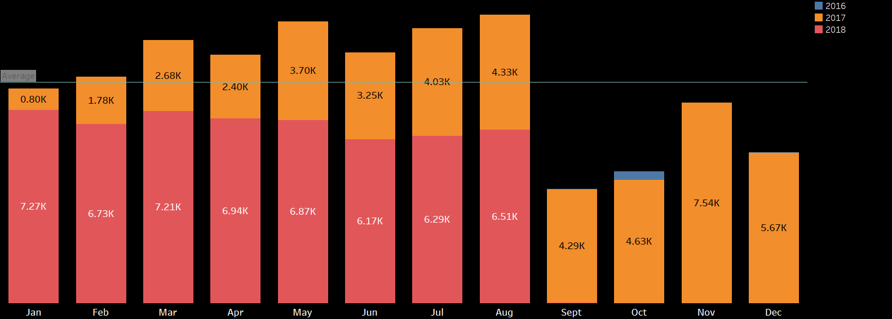
Orders Analysis
Overall 103.8k orders are placed on Olist Store.
The Orders Data Is between Sep-2016 And Oct-2018. Average Orders Per Month for year 2016,2017 & 2018 are 0.1k, 3.8K & 5.4K Respectively.
Average orders are around 8.3k per month( Overall )
In year 2018 orders growth increased by 20% compare to previous year.

Slide 7
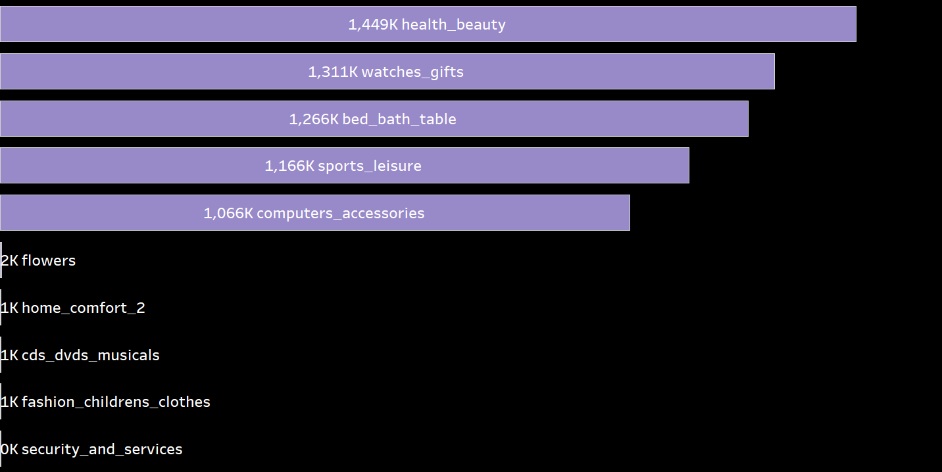
Products Analysis
Health_Beauty,watches_gifts,bed_bath_table,sports,computer_accessories are the Popular Products Categories.
In All of 73 products ,These 5 Products accounts for over 39% of total item orders.
Health&beauty item holds 9% of total revenue
To 5 products accounts $6.25M(39%) out of Total revenue
All of this top popular products has a 4 star review averagely but bed bath table product has an review 3 star

Slide 8
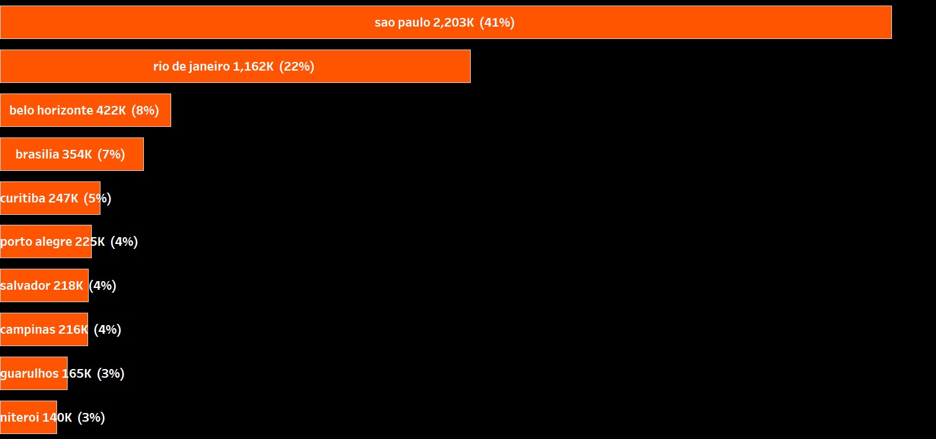
State & City Analysis
Sao Paulo,rio de janerio are the top cities for sales.
SP State is main market and holds 71% of Order shares of total orders in all the states
70% Customers are from SP state.

Slide 9
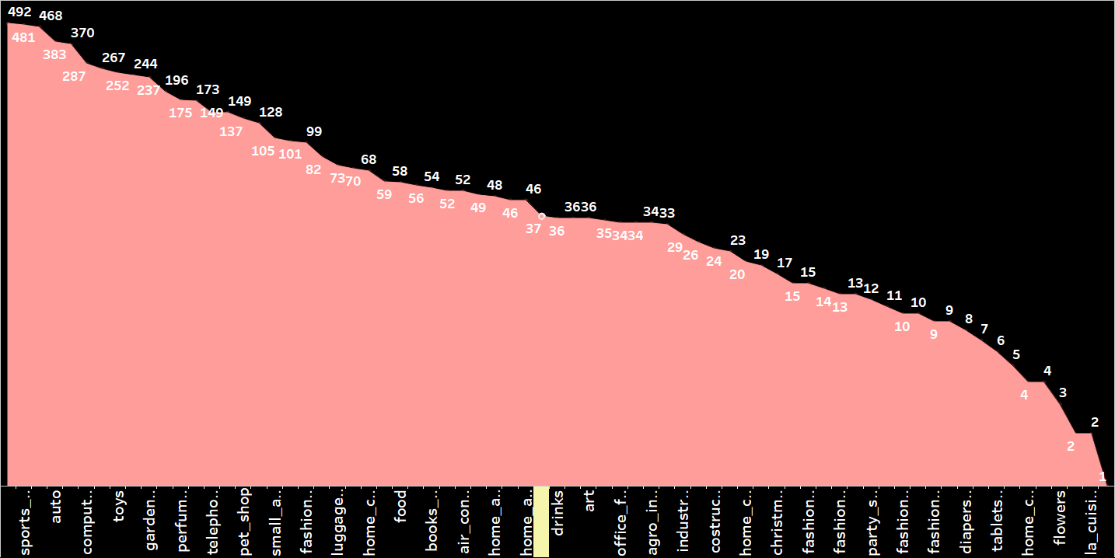
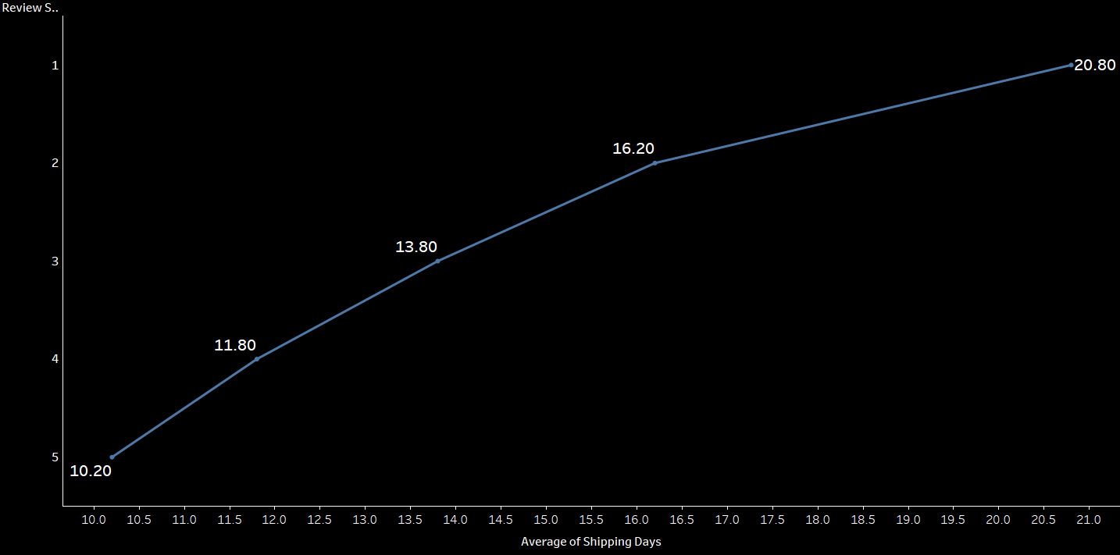
Sellers Analysis
Sellers of popular categories are around 70% than other products
SP state accounts 59% seller than all other states sellers.
Sau paulo city holds 61% sellers than all other cities.
Shipping Days are averagely 8 Days for Sao paulo City & state and review score is around 4.1
Averagely 4.8 star rating from customers

Slide 10
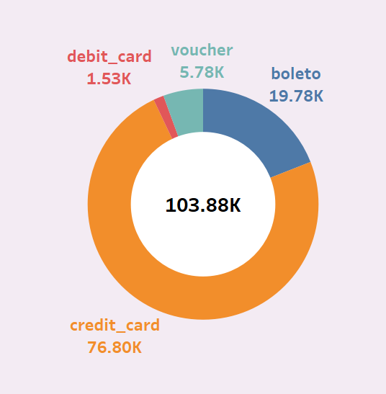
Customers and Orders analysis
Total customers are around 96k and Total orders Placed are around 99.4K
2997 customers out of 96.09K customers placed Repeat orders
Out of total revenue($ 16.1M) this customers accounts $994.4k
93.1k customers placed one time orders accounts $ 15064k payments
Over 625 orders are cancelled and they gave 1 star rating
96.4k orders are delivered they gave 4.1 star rating
Sao Paulo And Rio De Janeiro city has the most customers around 22k
Credit card is mostly used by customers for payments over 76K orders are placed using credit cards

Slide 11
Recommendation
Focus more on Top Products Inventory.
Most of the sellers are in SP state and That’s why revenue of this state is Great than other states. So We have to implement more sellers in all states.
Weekends are busier than weekdays so try to give discounts on payment methods that often used.
Sellers are very less for average categories. So Get sellers and suppliers for those least products to increase revenue
Consider to reduce products and items Like security service , kids-Fashion clothes, cd_dvds that had very less orders

Slide 12
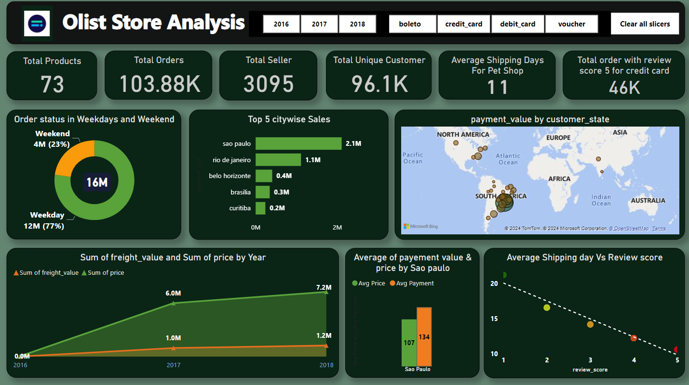
Power-Bi Dashboard

Slide 13
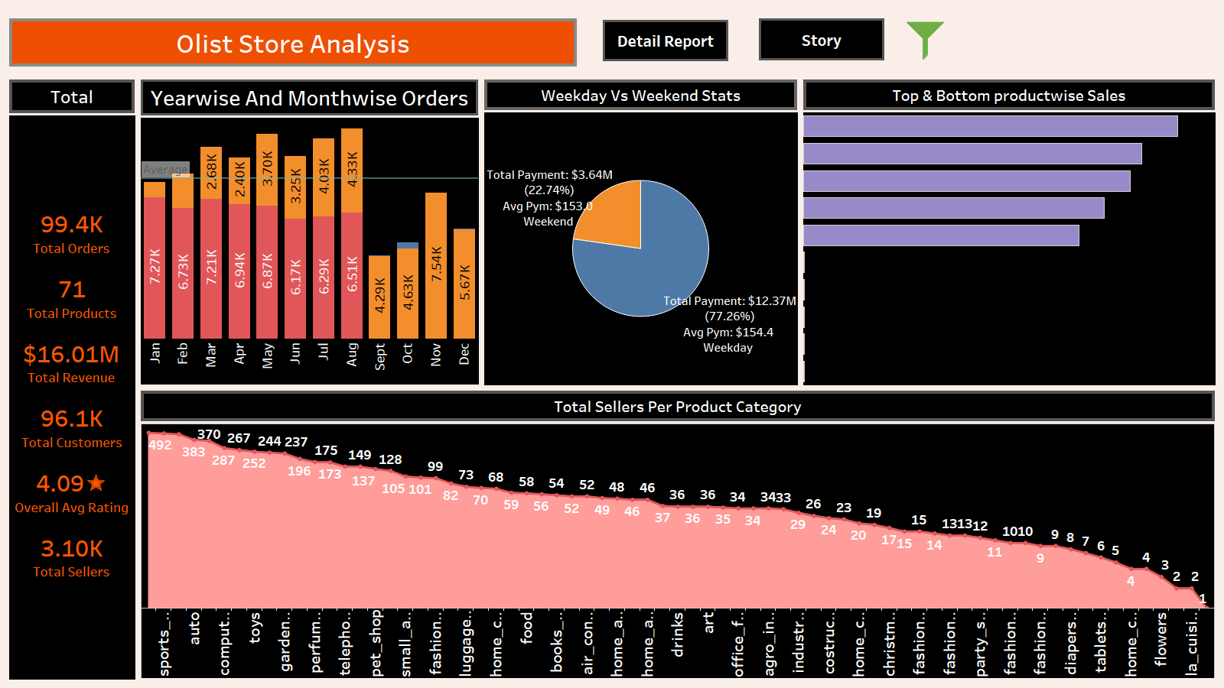
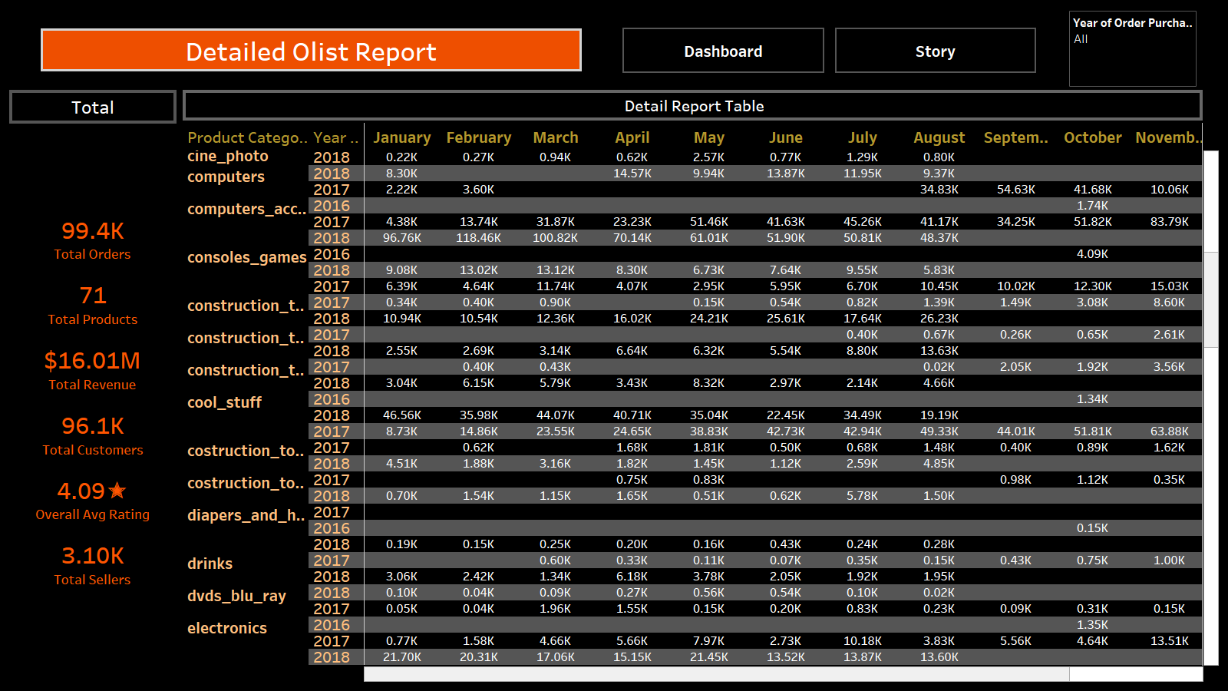
Tableau dashboard

Slide 14
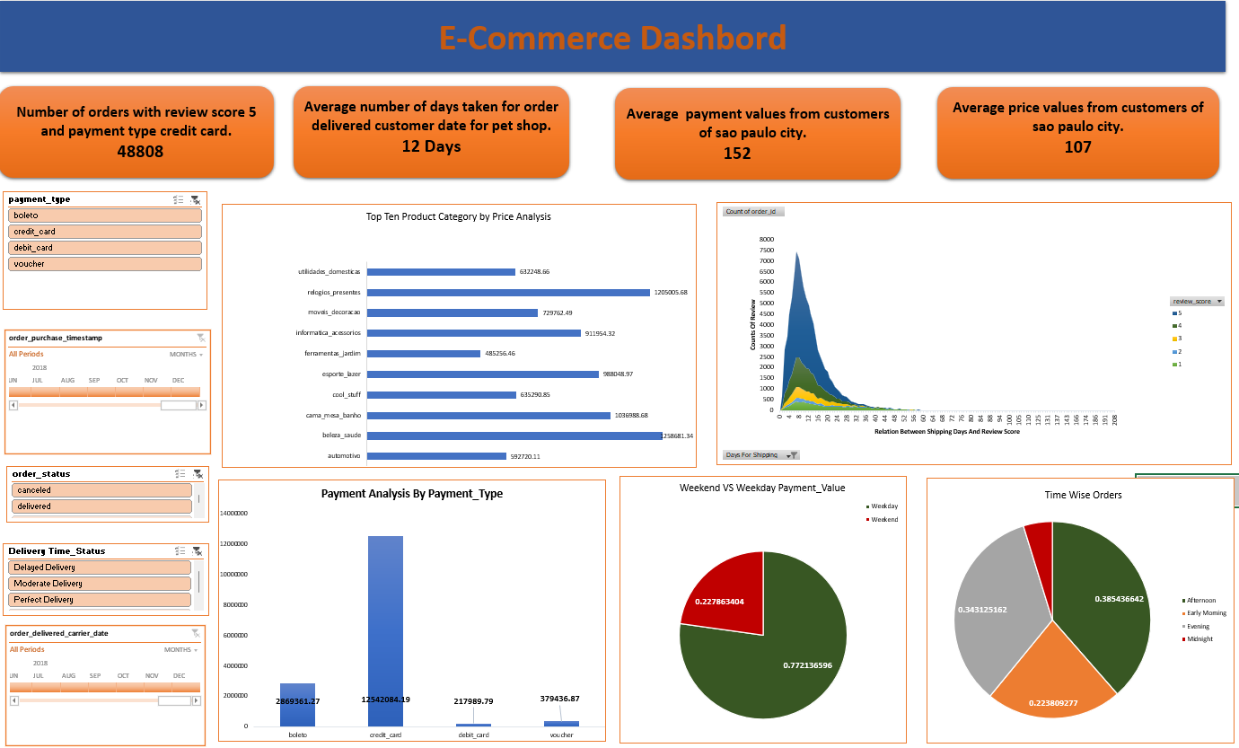
Microsoft-Excel Dashboard

